Slide 1
PHP and Forms
CS/IT 490 WD, Fall 2013

Slide 2
Breakdown
GET and POST
Handling form data
Form validation
Saving form data to a text file

Slide 3
GET and POST
When we create a form in HTML, we have the option to set its method attribute to “get” or “post”.
If you set it to “get”, then the name-value pairs for each input item will be displayed in the URL.
Post is more invisible, and does not affect the URL.

Slide 4
GET and POST
A URL with GET data can be cached, a POSTed form cannot be cached
GET has a maximum length, but POST does not.
If your form has a password field, after the submit is hit, the GET data will show up in the URL.
http://www.w3schools.com/php/php_forms.asp

Slide 5
GET and POST
In PHP, the associative array of form data can be accessed with
$_GET or
$_POST
http://www.w3schools.com/php/php_forms.asp

Slide 6
Handling form data
Remember that with form elements, you will be setting name attributes.
Values corresponding to these names may be typed in (text box, text area) or selected (check boxes / radio buttons)
The name/value pairs will show up in $_GET or $_POST once the form has been submitted.
Remember that the id attribute is for JavaScript, CSS, and XHTML. PHP cares about the names.

Slide 7
Handling form data
<input type="text" id="username" name="username" />
Will be accessible via:
$_POST["username"]

Slide 8
Handling form data
<input type="radio" id="ship1" name="shipping" value="home" />
Will be accessible via:
$_POST["shipping"]
If this first radio button is selected, then the value of $_POST["shipping"] will be “home”.

Slide 9
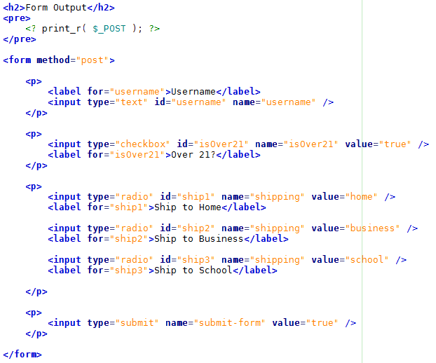
Handling form data

Slide 10
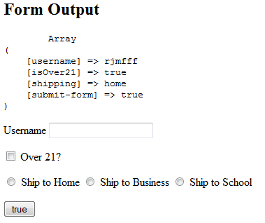
Handling form data
This sample code is under the folder “Forms” in the PHP folder.

Slide 11
Form validation
While you can validate a form with JavaScript to make sure that required fields are filled in, and of the right type...
You should always validate form data from the server-side!
JavaScript is good for quick feedback, but it can be exploited. Always make sure to validate the data with PHP!

Slide 12
Form validation
Regular Expressions are useful for form validation, but they can be a little hard to use in the beginning.
You can read a RegEx intro here:
http://www.zytrax.com/tech/web/regex.htm
Good RegEx tester:
http://www.regular-expressions.info/javascriptexample.html
RegEx Reference page:
http://www.regular-expressions.info/reference.html
We will do some basic examples later.

Slide 13
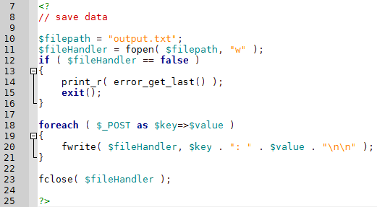
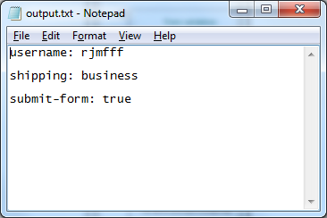
Saving form data to a text file
Sample code for saving form data is also on the class webpage.
Something similar will be used for Assignment 3

Slide 14
Practice
Just another concept that is best illustrated through actually working on something similar.
Sample code on class page should be for guidance.
We will work some samples in class.

Slide 15
References
-

